Slide 1
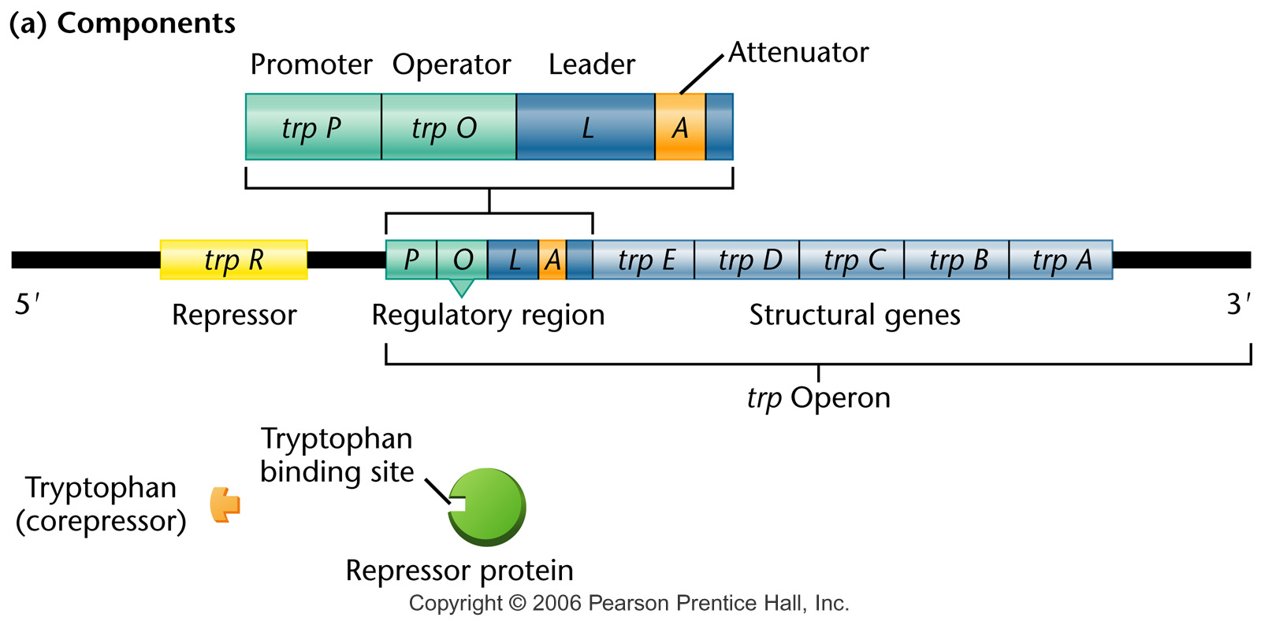
Components of trp operon
Notes:
Figure 16-12a (a) The components involved in the regulation of the tryptophan operon. (b) Regulatory conditions are depicted that involve either activation or (c) repression of the structural genes. In the absence of tryptophan, an inactive repressor is made that cannot bind to the operator (O), thus allowing transcription to proceed. In the presence of tryptophan, it binds to the repressor, causing an allosteric transition to occur. This complex binds to the operator region, leading to repression of the operon.

Slide 2
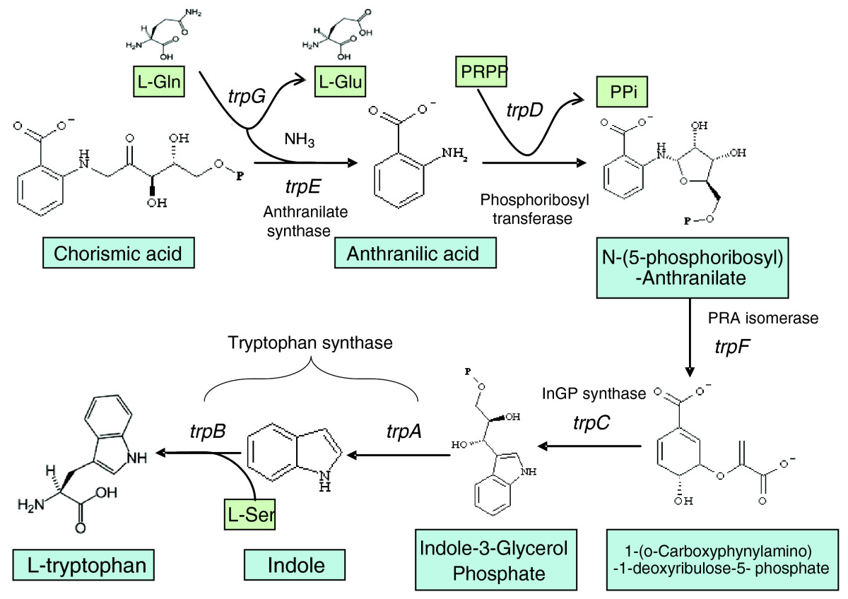
Tryptophan synthesis

Slide 3
The trp operon is a repressible system
The enzymes (5 structural genes) for tryptophan production form an operon.
In the presence of tryptophan, the operon is repressed.
Tryptophan functions as a corepressor, which is required for the repressor to bind to the operator.

Slide 4
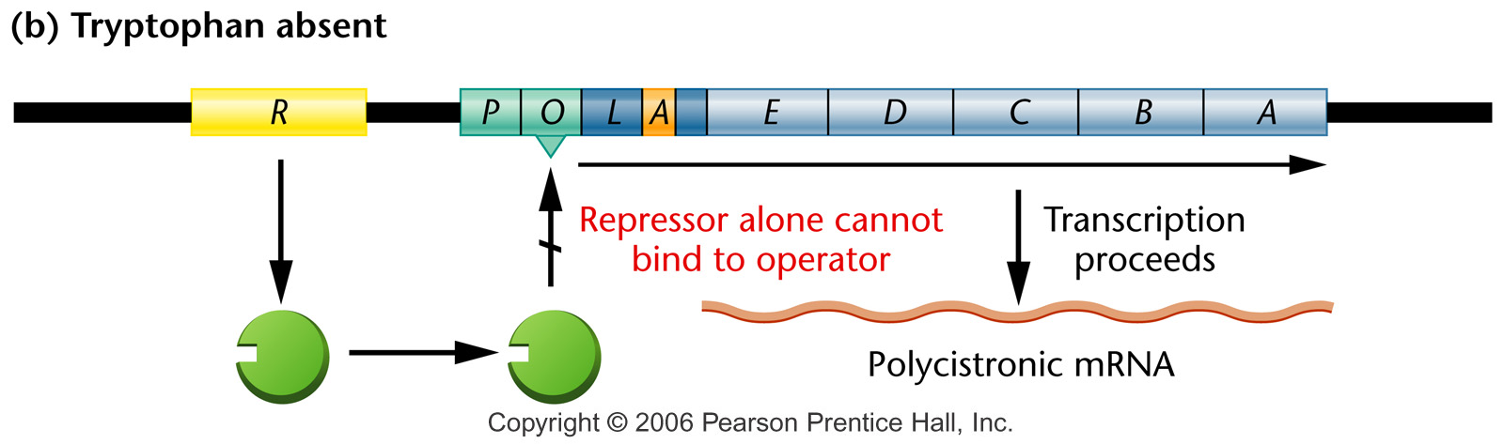
When tryptophan is absent
Notes:
Figure 16-12b (a) The components involved in the regulation of the tryptophan operon. (b) Regulatory conditions are depicted that involve either activation or (c) repression of the structural genes. In the absence of tryptophan, an inactive repressor is made that cannot bind to the operator (O), thus allowing transcription to proceed. In the presence of tryptophan, it binds to the repressor, causing an allosteric transition to occur. This complex binds to the operator region, leading to repression of the operon.

Slide 5
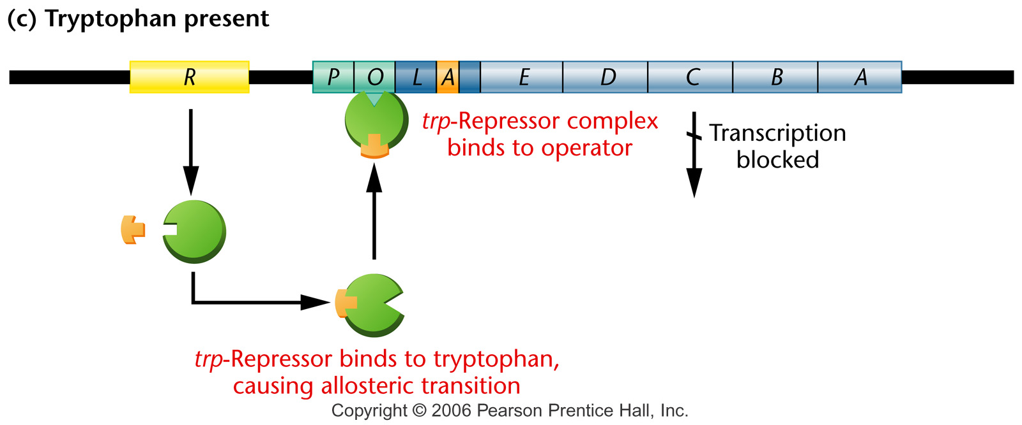
When tryptophan is present
Notes:
Figure 16-12c (a) The components involved in the regulation of the tryptophan operon. (b) Regulatory conditions are depicted that involve either activation or (c) repression of the structural genes. In the absence of tryptophan, an inactive repressor is made that cannot bind to the operator (O), thus allowing transcription to proceed. In the presence of tryptophan, it binds to the repressor, causing an allosteric transition to occur. This complex binds to the operator region, leading to repression of the operon.

Slide 6
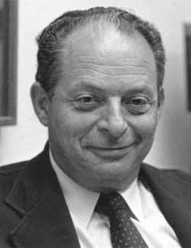
Attenuation in the trp operon
Charles Yanofsky

Slide 7
Attenuation in the trp operon
In the absence of tryptophan, transcription is not terminated in the leader region and proceeds through the entire operon.
Transcription of the leader region of the trp operon can occur even when the operon is repressed in the presence of tryptophan.
Attenuation is the mechanism by which expression of the rest of the trp operon is repressed after transcription of the leader sequence.

Slide 8
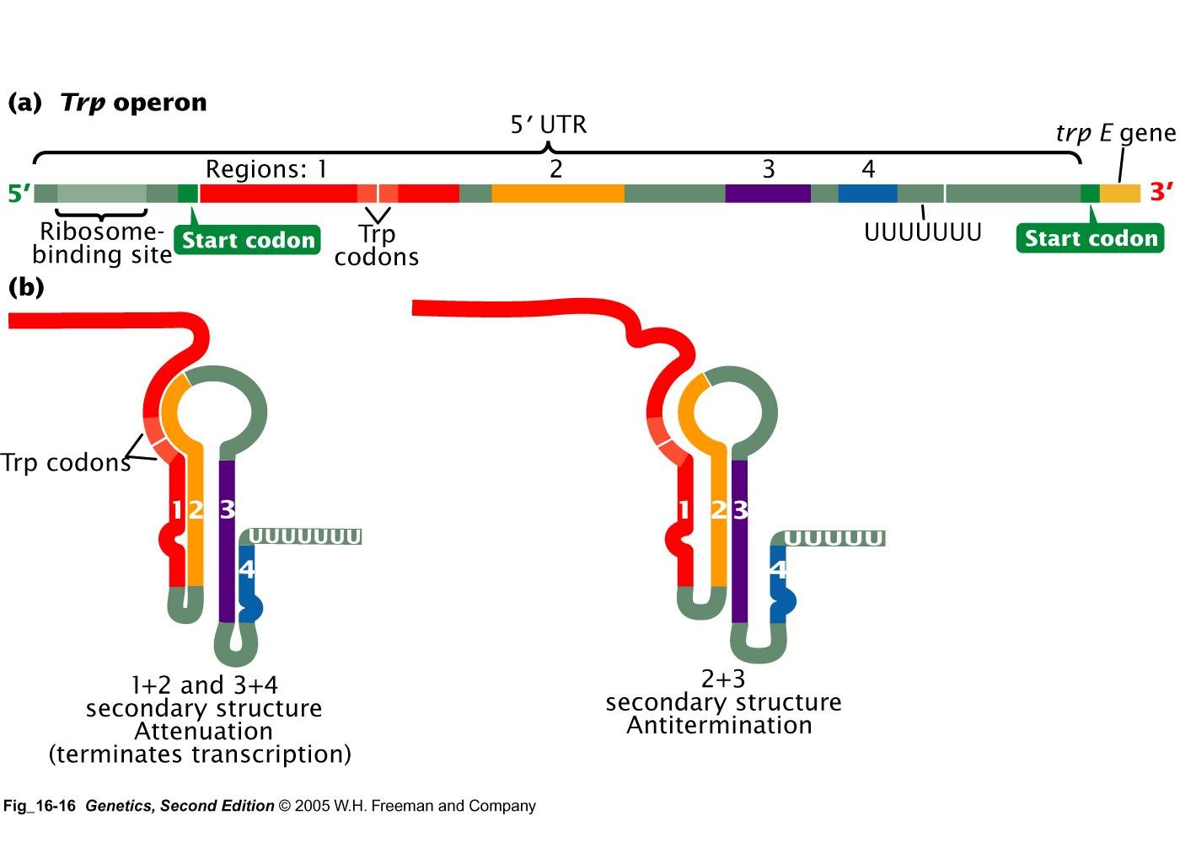

Slide 9
How does attenuation work?
The leader region can form two different conformations, depending on the presence or absence of tryptophan.
In the presence of tryptophan, the 3-4 hairpin structure forms and acts as a transcriptional terminator.
In the absence of tryptophan, a different hairpin (2-3) forms and acts as an antiterminator, and transcription proceeds

Slide 10
The key to trp attenuation
The leader region contains two tryptophan codons.
The antiterminator hairpin structure forms in the absence of tryptophan because the ribosome stalls at these codons because there is not adequate charged tRNA^{trp}.
In the presence of tryptophan, the ribosome proceeds through this sequence and the terminator hairpin can form.

Slide 11
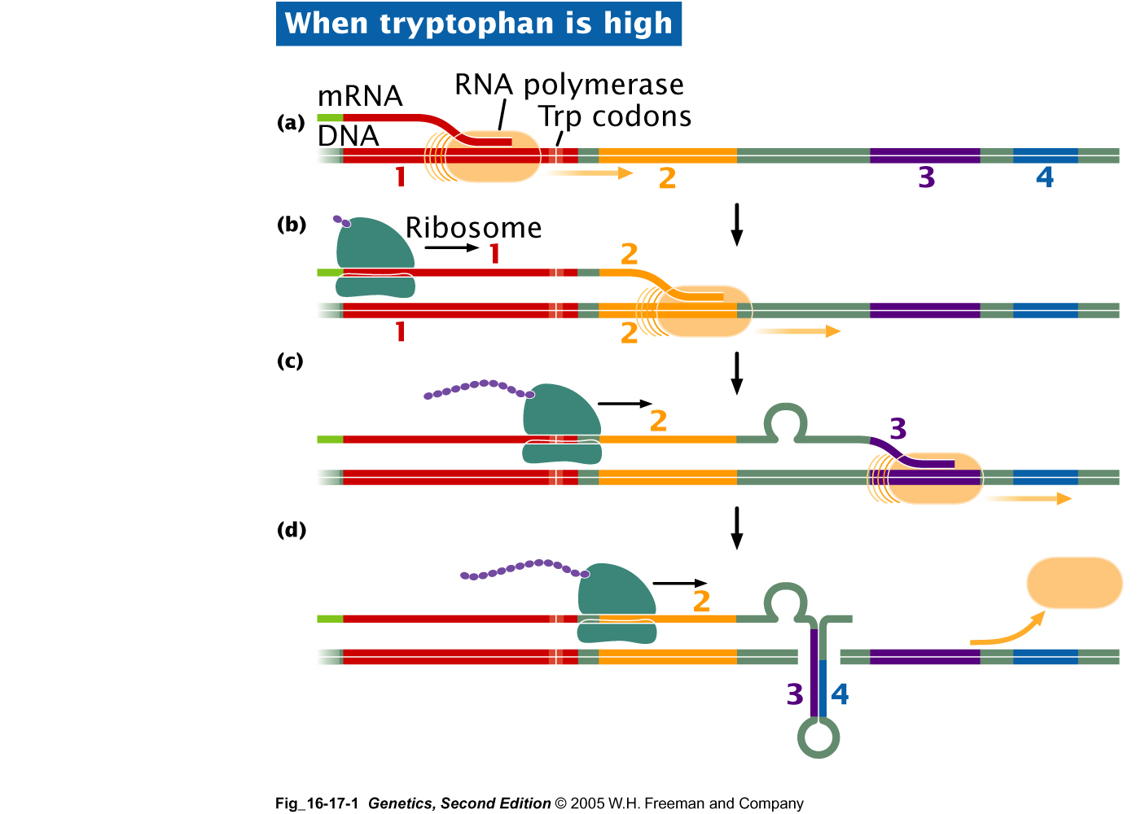

Slide 12
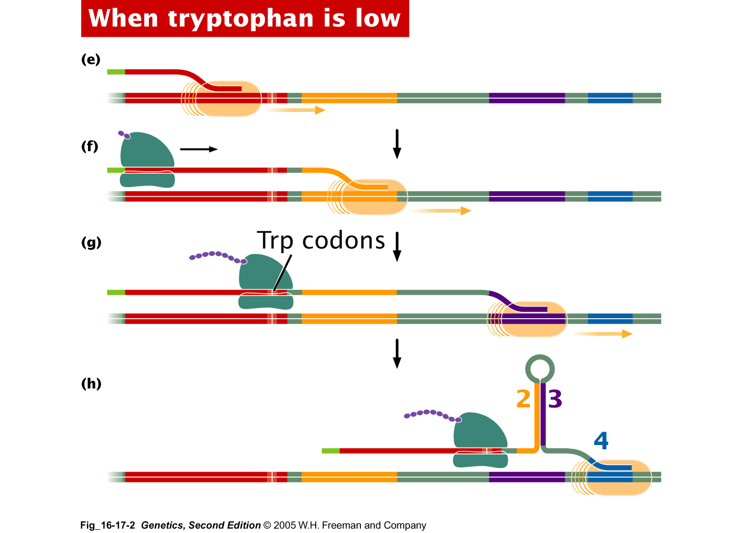

Slide 13
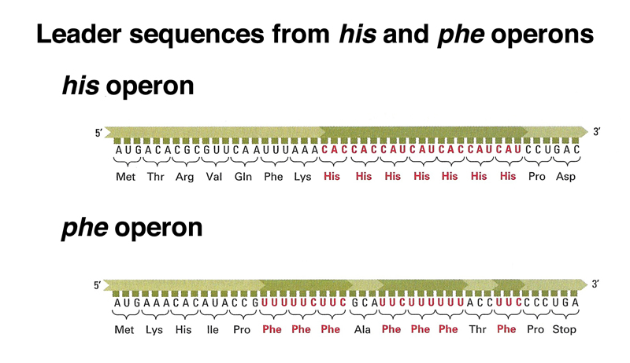
Attenuation in other operons
The attenuation mechanism is common to several operons for enzymes responsible for synthesis of other amino acids including threonine, histidine, leucine, and phenylalanine.
Not in eukaryotes. Why?

Slide 14
TRAP and AT govern attenuation in B. subtilis
Bacillus subtilis uses just attenuation and hairpins to regulate its trp operon. The mechanism of attenuation for the trp operon involves a protein called TRAP (trp RNA-binding attenuation protein).
TRAP has 11 subunits, each of which can bind one molecule of tryptophan. The fully saturated TRAP can then bind to the 5' leader sequence to form the terminator hairpin and prevent formation of the antiterminator hairpin

Slide 15
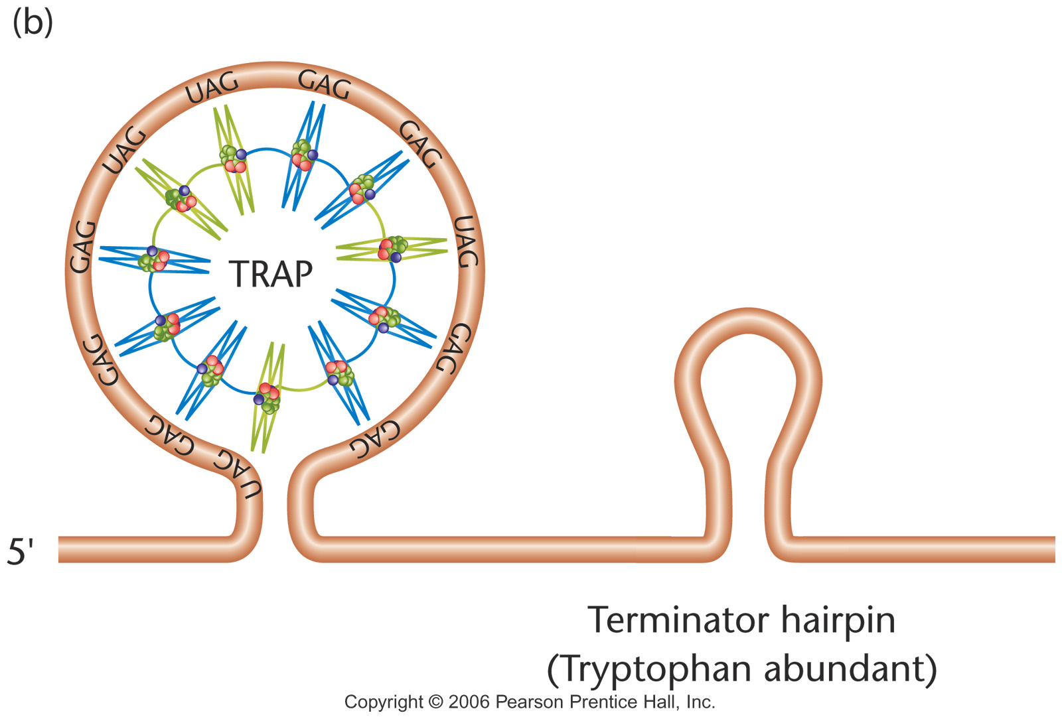
Notes:
Figure 16-14b (a) Model of the trp RNA-binding attenuation protein (TRAP). The symmetrical molecule consists of 11 subunits, each capable of binding to one molecule of tryptophan that is embedded within the subunit. (b) The interaction of a tryptophan-bound TRAP molecule with the leader sequence of the trp operon of B. subtilis. This interaction induces the formation of the terminator hairpin, attenuating expression of the trp operon.

Slide 16
AT inhibits TRAP
Uncharged tRNA^{trp} induces expression of the anti-TRAP (AT) gene. The AT protein associates with TRAP in the tryptophan-activated state and inhibits binding to the target leader RNA sequence.

Slide 17
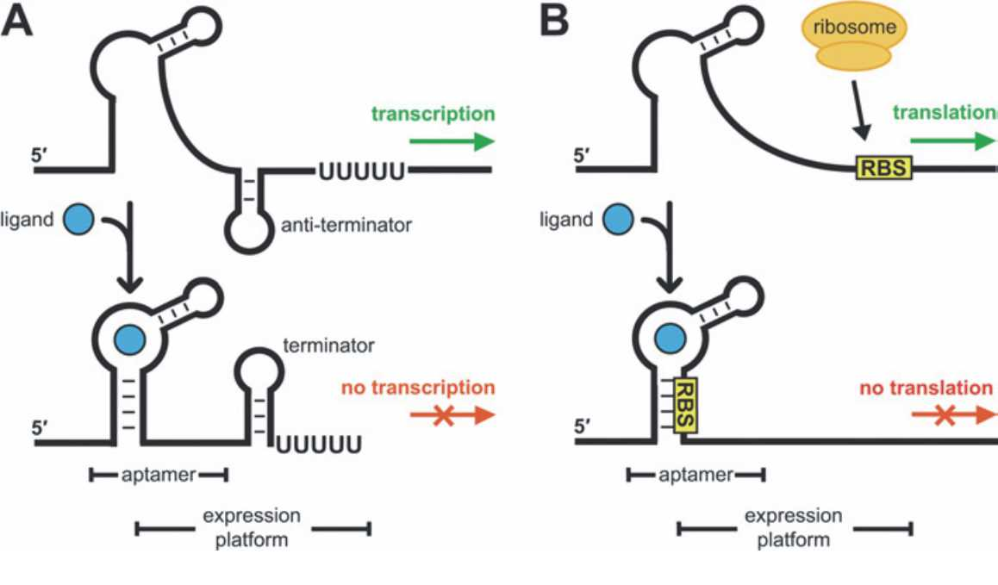
Attenuators

